Slide 1

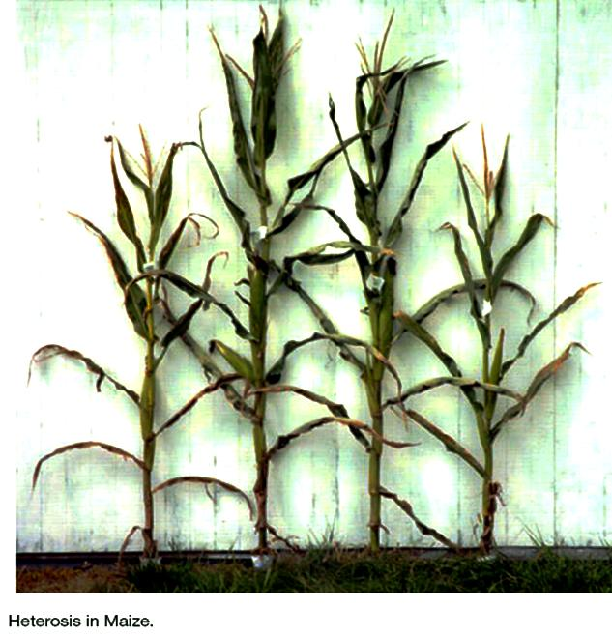
https://www.uni-goettingen.de/en/48115.html
Heterosis with maize as example. One individual from each of two inbred maize lines (B73 left and Mo17 right) and two hybrid individuals (B73/Mo17 and Mo17/B73); female parent named first since this is plant breeding not animal breeding). F1 is taller and higher yielding than the parents. Photo is taken from Figure 1 in Birchler et al., 2003.
UNPLAB-BrMeth_Ch-2[Heterosis]
Heterosis, Hybrid Vigour, Inbreeding Depression
1

Slide 2
Sequential Number: #20
UNPLAB-BrMeth_Ch-2[Heterosis]
Unless I explicitly state otherwise, images and cartoons are created using ChatGPT.
You may use this material free of charge under the terms of the CC BY license. This requires that you provide appropriate attribution to the author: W. Link, University of Goettingen, Germany.
In a few cases, individual images, photographs, or similar material may be subject to a more restrictive Creative Commons license. Where this applies, it is explicitly indicated, and you must comply with the stated license terms for those items.
Please check the license information carefully before reuse. Responsibility for complying with the applicable license terms rests entirely with you.
2

Slide 3
You already know: Population Genetics. GxE. Breeder’s Equation.
Keywords of this chapter: Heterosis, Inbreeding Depression, Definition, Assessment, Relation between Heterozygosity and Heterosis
Algebra as introduced in this chapter:
Inbreeding coefficient of genotype X, stemming from mating of half-sibs, is F(X) = (1/8) ∙ [1 + F(A)].
F(A) is the inbreeding coefficient of the shared (common) ancestor A of the parents of X.
If A is not inbred, then F(X)=1/8.
If A was fully inbred (fully homozygous), then F(X) = ¼.
3

Slide 4
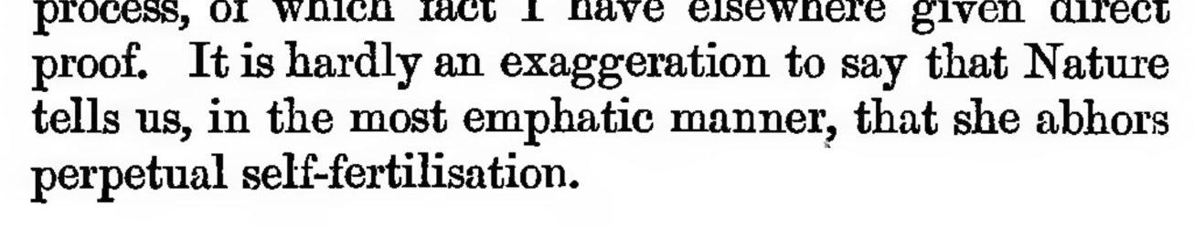
Heterosis is a semi-mysterious biological-genetic phenomenon. Its exploitation
has a major impact on yield and further performance-related traits, similar in impor-tance as N fertilization or irrigation, sometimes up to a doubling yield (compared to the situation without heterosis).
Heterosis is exploited in all modern maize cultivars (hybrid cvs.) and all other hybrid cvs. of crops such as sugar beet, rye, sorghum, sunflower etc., as well as in clone cvs. (such as grapevine, potato, sugar cane, fruit trees and many more) and in all population cultivars (clover, grass, etc.); and in all livestock breeding.
Heterosis is only absent in line cvs. (wheat, barley, oat, soybean, pea, others).
So:
This phenomenon is important enough to very patiently study it :-)
Darwin, C., 1877. The various contrivances by which orchids are fertilized by insects.djvu/313
4

Slide 5
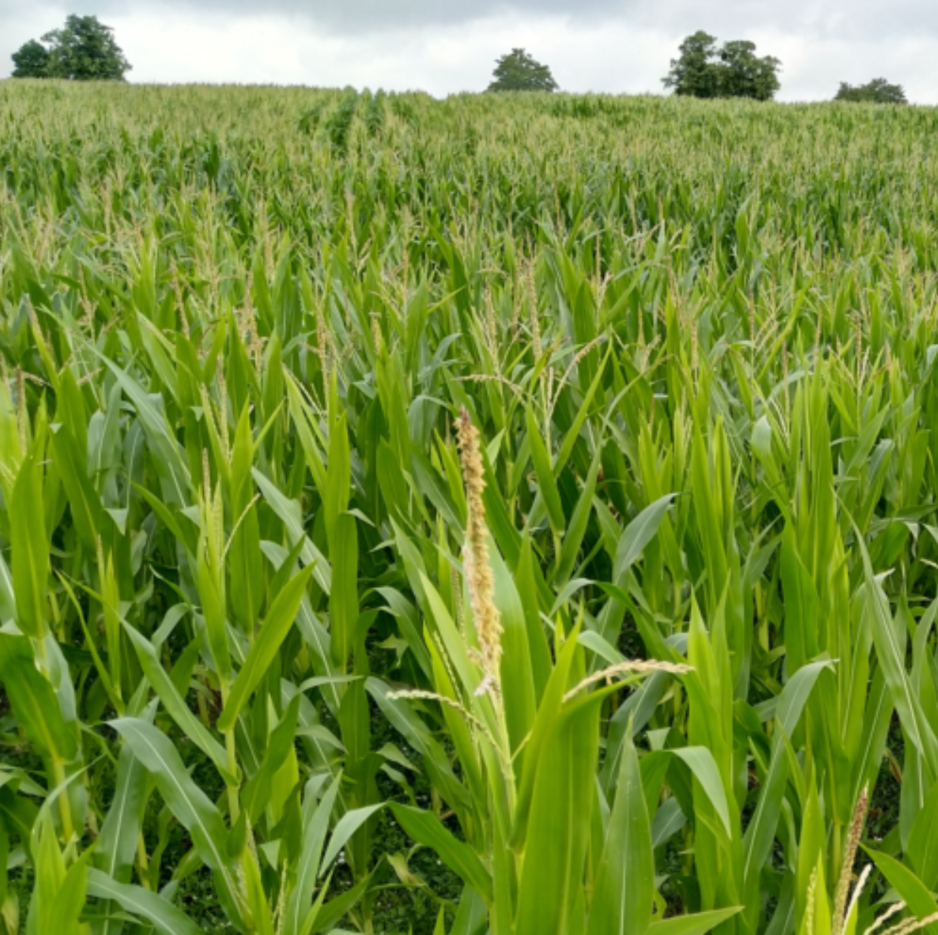

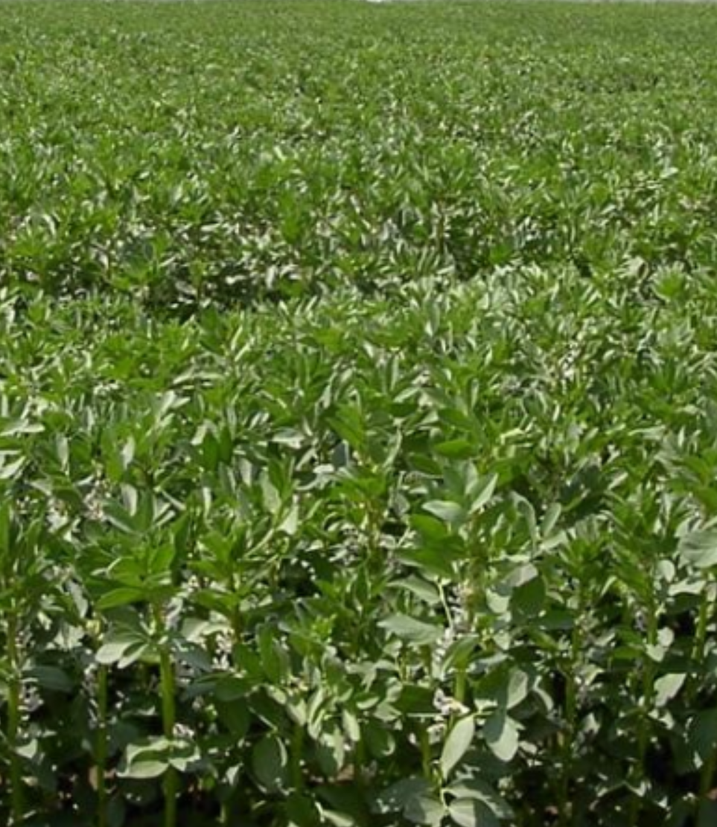
Definition. Genetic basis of Heterosis
Normalhöhennull (‚Standard Elevation Zero‘) informs about the height of a topogra-phical spot above mean sea level. By the way, the Brocken mountain NHN is correctly 1141m even though the label (see photo) reads 1142m.
© T. Beissinger
5
Just like elevation needs a fixed Reference Level, levels of inbreeding need a refe-rence level. Repeatedly mis-understandings in this area of research are caused by hopping between References without explicitly telling or taking note.
The zero level of inbreeding is fixed via the genotype frequencies of the Reference or Base Population (which is in HWE; per definitionem). The 100% level of inbreeding as Reference is employed when assessing pertinent 100%-homozygous genotypes.
Populations © W. Link

Slide 6
Definition, genetic basis of Heterosis. What may ‚zero-inbreeding‘ mean?
The members of the Reference Population (Base Population, basic germplasm pool) are zero-inbred. That population is in its* Hardy-Weinberg Equilibrium (*it shows P=p², H=2pq, Q=q²; due to random mating; no Selection-Mutation-Migration-Drift). Popula-tions may be ‘in’ HWE yet be nevertheless more or less inbred: e.g. Random Drift causes inbreeding although random mating may cause HWE in such ‘narrow’ population; e.g. a Mendelian F₂ population is (‘1 : 2 : 1’) in HWE, yet is inbred (F=½).
The zero level of inbreeding is fixed via the genotype frequencies in the Reference (Base) Population (in HWE, per definition). If you declare your narrow, partly-inbred yet random-mating population to be your current Reference, then with this decision it is - suddenly - zero inbred; and convincingly so if it is in its HWE ;-) .
Inbreeding: Caused by mating of relatives. Relatives share ancestors. The ‘hardest’ version of inbreeding is self-fertilization (‘Mama and Papa are identical’). Inbreeding increases homozygosity. Yet, there is homozygosity even in the Reference Population (e.g. P[A1A1] = p²[A1] ). This is for alleles that are (1) alike in state (AIS; zustandsgleich) but not (2) identical by descent, IBD (see UNPLAB-PopGen_Ch-3[Inbreeding] p. 25-36).
The discussion of Inbreeding and of the Inbreeding Coefficient F is entirely focussing on homozygosity of IBD-type-of alleles: Only homozygosity of alleles that are copies of the same ancestral alleles counts. Homozygosity of two alleles with independent sources is not an inbreeding-relevant type of homozygosity (ISBN 0-582-44195-1).
© wlink
6
AIS vs. IBD is more a conceptual than a biochemical difference (UNPLAB-PopGen_Ch-3[Inbreeding])

Slide 7
Although we studied this topic already in UNPLAB-PopGen_Ch-3[Inbreeding],
we invest some energy on this here again … it is helpful to have these concepts fresh-and-clear in mind when discussing Heterosis and Inbreeding Depression.
 Alike in State (ais)
 Identical by Descent (ibd)
https://cnsgenomics.com/data/teaching/SISG/module_1/Module01-Lecture-Notes.pdf
7

Slide 8
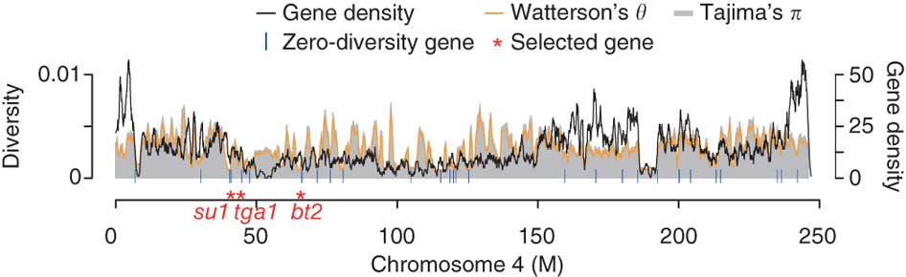
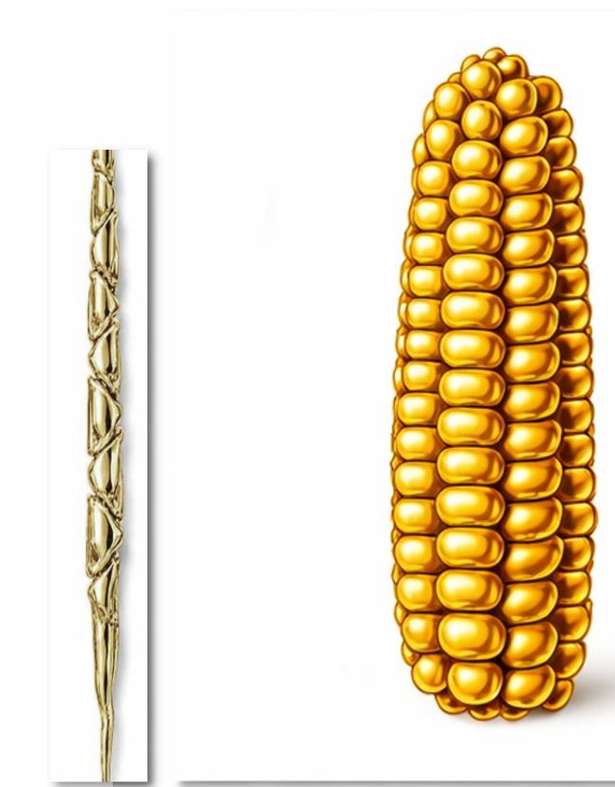
8
Definition, genetic basis of Heterosis. What may ‚zero-inbreeding‘ mean?
Z.m.p. Z.m.m.
https://doi.org/10.1038/ng.684
Even in maize, a species that is genetically as diverse as ‘humans-plus-chimpanzee’ (!), many genetic loci show zero diversity. There is but one allele at these loci in the entire species. Maize is, for example, monomorphic at the locus ‘teosinte glume architecture TGA’ for the tga1-allele, which explains a large proportion of the difference between teosinte and maize female flower anatomy (DOI 10.1111/nph.15350). This homozygosity is not indicating inbreeding (well ... ;-) as long as teosinte Z.m.p. is not included in the Reference Population to define zero-inbreeding of a maize genotype or population).
Heterozygosity at monomorphic loci is of course impossible (neglect mutations). This is even more frequently true in less wide species (a ‘narrow’ species is e.g. chickpea, Cicer arietinum).
8

Slide 9
AIS. IBD. Genes ‘move’ through generations. A conceptual thing, yet, enlightening.
If we know, e.g. from pedigree records that the very ancestor (member of Base Population) that inherited the red A1 gene was different from the ancestor that gave the blue A1 gene, then we take A₁A₁ as AIS-homozygous yet not as IBD-homozygous. Yet, if both came from the same an-cestral allele (same colour), then they are IBD (hence AIS anyway).
If we change our Reference, then we change our data basis, and so our definition of what is AIS or IBD may change. This is strange but still logic. It follows from the fact that all individuals are unreal-ted to all others (by definition) in the Reference Population – whatever we chose as Ref. Pop.
Generations
A₁A₁
A₁A₁
A₁A₂
A₂A₂
9
AIS
IBD
Heterozygous
IBD

Slide 10

Alike in state (AIS). Identical by descent (IBD). A conceptual thing, yet, enlightening.
A Prophet who is partly blind, just as we here are partly blind for earlier generations
Generations
If we changed our Reference, we changed our data basis, and our definition of what is AIS or IBD will change. This is (not) strange but logic.
It follows from the fact that it is in the ►Reference Population where all individuals are unreal-ted to all others (again and again: By Definition).
A₁A₁
A₁A₁
A₁A₂
A₂A₂
AIS
IBD
Heterozygous
AIS
10

Slide 11

Cat Stevens (CC BY 2.0; https://de.wikipedia.org/wiki/Cat_Stevens)
Cat Stevens: ‘The First Cut Is The Deepest’
Rehearsal. Percent heterozygosity. Inbreeding coefficient.
What is the percent of heterozygosity in a Mendelian F1-hybrid?
What is the percent of heterozygous loci in a Mendelian F2 (average of all F2-individuals)?
What is the inbreeding coefficient of a Mendelian F1-hybrid
What is the pedigree-based inbreeding coefficient of a Mendelian F2 (the individuals, the F2 generation)?
And in F3? And in F∞?
What is the inbreeding coefficient, if you took all DH-lines from a Mendelian F1-hybrid and cross them with each other by random mating?
It is the same as the percent of loci at which the
parents carried different alleles. Focus directly on
two randomly drawn (from base population) gametes,
then the probability of the F1 to be homozygous is
P+Q=p²+q² , to be heterozygous, it is 2pq (per locus, of course).
Half of what we see in the F1 that gave, via selfing, this F2 generation.
Well, the question should state whether the parents are un-related. If they are un-related, then the Inbreeding Coefficient of their offspring is zero, F=0 and hence P=1 (P = Panmictic Index = 1-F).
See number 3. If F=0 in F1, then F= ½ in F2. The first generation of self-fertilization leads the largest step towards homozygosity (‚the first cut is the deepest‘).
The series is F= ½, ¾, ⅞, and so on, towards F~1.
Think about it by yourself. You will realize that each DH-line was developed from a random (female or male) gamete. Hence, the pa-nel of DH-lines ‚coming‘ from an F1-hybrids represents genetically the panel of gametes that would have come from it. And you will realize that self-fertilization is a step of random mating among the gametes that come from the same genotype. Et cetera.
11
11

Slide 12
Inbreeding Coefficient when crossing half-sibs (half-sib siblings, Halbgeschwister)
The inbreeding coefficient F(X) of an individual such as X describes the probability that two alleles at a random locus of X are IBD.
Take B, A, C as (unrelated) members of the Reference Population.
The offspring X has only three instead of four grand-parents, this is because its parents P and Q were half-siblings and shared one ancestor (A). Due to this, for each locus there is the probability 1 in 16 that e.g. (a copy of) the allele A1 from A is transferred to X via P and simultaneously from A to X via Q. Each single transfer (each arrow) A to P, P to X, A to Q, Q to X represents the probability 1/2, in total we see thus P(X is A1A1)=(1/2)⁴ = 1/16. The total probability for X to be homozygous for either A1 or for A2 amounts to 2 ∙ (1/2)⁴ = 1/8.
In case the ancestor A has already been inbred, the inbreeding coefficient of X increases.
The actual genotype of B and C are irrelevant for our question. They may be such as both A1A2 or such as A3A4 and A5A6: B, A, C are unrelated, thus alleles of B and C are not IBD with the alleles of A.
ISBN-13: 978-3110075618
In General:
F(X) = (1/8) ∙ [1 + F(A)]. If A was homozygous, then F(X) = ¼ (as you easily see from my chart).
12

Slide 13
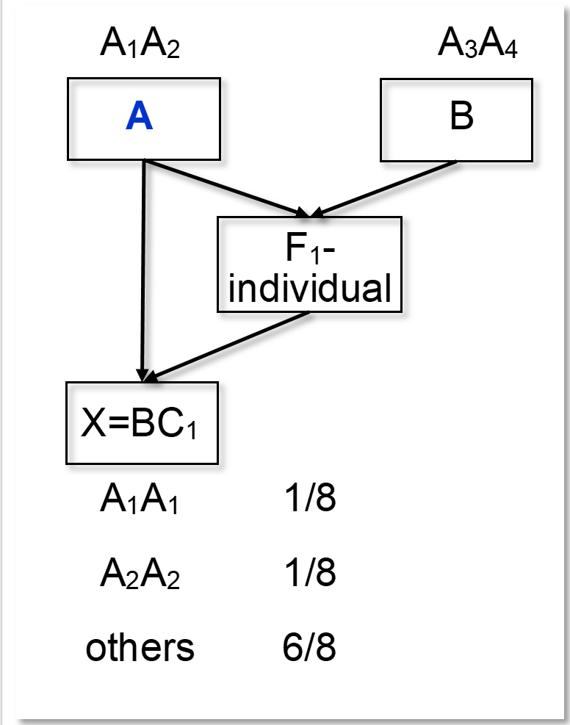
Inbreeding coefficient of a ‘back-cross’ (of an offspring from ‘back-crossing’)
Contemplate the inbreeding coefficient of the offspring X which came from back-crossing. Take A and B as non-inbred and non-related initial parents.
A was mated with B. One of their F1-hybrid offspring individuals was ‚again‘ mated with A (‘back-crossed’; we must assume that A lives long enough for this second mating).
What is the inbreeding coefficient F of the BC₁[A x F₁(AxB)]? or of BC₁[F₁(AxB)xA]?
The back-cross offspring X has two parents, A and this F₁-individual; its parents are related; A is one parent of that F1). Therefore, for each locus there is the probability (½)³ = ⅛ that e.g. the allele A₁ is transferred from A to BC₁ via the F₁-plant and simultaneously directly from A to BC₁. There are two options for X to become homozygous for IBD-alleles: either A₁A₁ or A₂A₂. Hence, the total probability for BC₁ to be IBD-homozygous is F= 2 ∙ (½)³ = ¼. F of the BC₁[A x F₁(AxB)] = ¼.
If the X is ‚again‘ back-crossed to A, then the inbreeding coefficient of this second back-cross BC₂ is F=0.375 = ⅜. Further back-crossing leads here towards a maxi-mum value of F = ½. This is because the BC-offspring become more and more similar to A, and finally the situation is like self-fertilizating A (hence F = ½).
ISBN: 0-89925-143-9
Be cautious: A and B are taken here as non-inbred.
In Plant Breeding, typically they would be homozygous ;-) thus F of the BC₁ would be F= ½ instead of ¼.
13

Slide 14
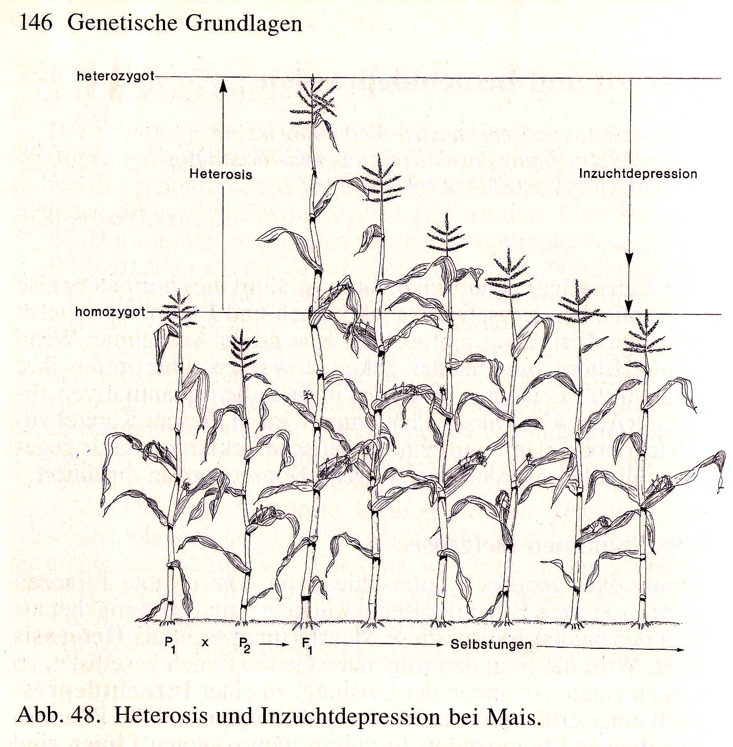
Heterosis
Heterosis is an important topic for genetics as well as for animal and plant breeding. The basic observation is that offspring from crosses among relatives tend to be less vigo-rous, more sensitive, less yielding, whereas if parents are markedly distant such as from different germplasm pools, their cross-bred offspring tends to be more vigorous, more beautiful, higher yielding and more resilient than expected. Differences between parents increase heterozygosity of offspring, therefrom the term ‚stimulus of heterozygosis” or “heterozygotic stimulation”, in short: Heterosis.
Heterosis is typically described in adult traits such as yield or plant height. Yet, Heterosis is already manifested during seedling develop-ment. Heterosis increases Vigour and Speed of Development, not always of ‘Agronomic Value’ such has resistance and quality.
Non-inbred
Heterosis
Inbreeding Depression
Homozygous
Selfings
Heterosis & Inbreeding Depression in maize. Heiko Becker, 2011
14

Slide 15
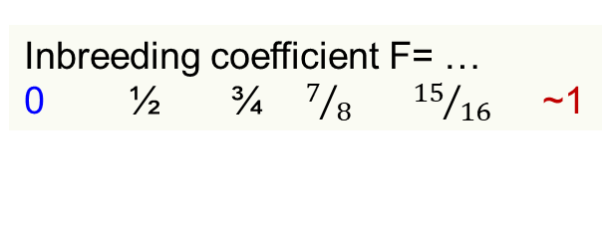
Definition and further comments on Heterosis (Hybrid Vigour; Bastardwüchsigkeit).
Inbreeding coefficient F= …
0 ½ ¾ $7/8$ ${15}/{16}$ ~1
Heterosis is defined as the difference of performance in generation F1 compared to the average of the homozygous parents (‘mid-parent’). Heterosis = F1 - ½(P1 + P2).
The reference for heterosis is the parent’s mean-value-of-trait. Mind: Parents are fully homozygous. If parents are not homozygous, then F1 minus parental mean is not Heterosis.
We can always think about the performance
of non-existing, ‘homozygous-conceptual-parents’. Such parents did always ‘nearly’ exist, at least the actual gametes that united to give rise to the F1-genotype did indeed exist. These two very gametes, transformed into diploid (and of course thus homozygous) plants, would have been the adequate parents P1 and P2 to assess heterosis of their hybrid.
We neglect ‚better-parent heterosis‘ and focus on ‘mid-parent heterosis’.
Non-inbred
Heterosis
Inbreeding Depression
Homozygous
P1 x P2► F1
►►►►
Selfings
►►
F∞
Heterosis & Inbreeding Depression in maize. Heiko Becker, 2011
15

Slide 16
Heterosis. Drawing shows heterosis for plant height. Heterosis is trait-specific.
F1
Non-inbred
General “rules”
Heterosis is marked for most quantitative traits (except traits like %-content of a compound, e.g. seed protein content).
Heterosis is usually smaller in self-fertilizing crops (e.g. barley) than in cross-fertilizing crops (e.g. rye).
Heterosis is usually larger in traits that are connected with Fitness (grain yield, number of ears per plant) than in other traits such as morphology (plant height, leaflet width).
Heterosis is usually the larger the more the parents differ genetically from each other (the less genetically related they are).
Sometimes heterosis is quantified as ‘% diffe-rence’ of F1 versus parental mean instead of ‚absolute difference’ in trait units.
Heterosis
Inbreeding Depression
Fully inbred
P1 x P2► F1
►►►►
Selfings
►►
F∞
Heterosis & Inbreeding Depression in maize. Heiko Becker, 2011
16

Slide 17
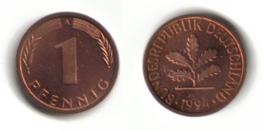



Relationship between heterozygosity, inbreeding coefficient, heterosis and performance.
Heterosis & Inbr. Depression are 2 sides of same coin
Brünjes, 2017
Heterosis & Inbr. Depression are 2 sides of same coin
8
F₁ hybrid
7
6
Inbreeding
Depression
Heterosis
Yield (t/ha)
5
4
3
F₃
Generation
mean
F₂
Gen.
mean
2
Parental
or F∞
mean
Inbreeding
minimum
1
0
Line1
P1
Line2
P2
1.00
0.75
0.50
0.25
0.00
Inbreeding coefficient
17

Slide 18
Relationship between heterozygosity, inbreeding coefficient, heterosis and performance.
Heterosis & Inbr. Depression are 2 sides of same coin
Typically in plants and animals, empiricism tells us about a rather linear relationship between trait expression such as yield or general vigour and inbreeding coefficient (provided Selection, Muta-tion, Drift is avoided). Deviation from linearity is sometimes analysed to extract information about epistasis (and further potential ‘reasons’ for such deviations).
Yet, such linearity is no genetic rule like “1:2:1”;
it is only a frequent experimental observation.
Brünjes, 2017
Heterosis & Inbr. Depression are 2 sides of same coin
8
F₁ hybrid
7
6
Inbreeding
Depression
Heterosis
Yield (t/ha)
5
4
3
F₃
Generation
mean
Parental
or F∞
mean
F₂
Gen.
mean
2
Inbreeding
minimum
1
0
Line1
P1
Line2
P2
1.00
0.75
0.50
0.25
0.00
Inbreeding Coefficient F
Kumari et al. 2008. Indian J. of Genetics and Plant Breeding 68, 124–131.
Sewalem et al., 2006. Dairy Cattle Journal of Dairy Science 89, 2210-2216.
Falconer and Mackay, 1996. Introduction to Quantitative Genetics. Longman.
Lamkey and Edwards, 1999. Quantitative Genetics of Heterosis. ASA, CSSA, SSSA.
18

Slide 19
Relationship between Heterozygosity, Inbreeding Coefficient, Heterosis & performance.
Heterosis & Inbr. Depression are 2 sides of same coin
If you calculate the difference between F1 and the (mean of the) F2-generation, then you estimate ½ Heterosis.
If you calculate the difference between F2 and F∞, then … same.
If two parents* of a cross happened to be F=⅓ inbred, then the differ-rence between their hybrid population and these two parents estimates ⅔ of the heterosis in this cross. ☺
Brünjes, 2017
Heterosis & Inbr. Depression are 2 sides of same coin
8
F₁ hybrid
7
6
Inbreeding
Depression
Heterosis
Yield (t/ha)
5
4
3
F₃
Generation
mean
Parental
or F∞
mean
F₂
Gen.
mean
2
Inbreeding
minimum
1
0
Line1
P1
Line2
P2
1.00
0.75
0.50
0.25
0.00
Inbreeding coefficient
*unrelated, of course
It is not true – though you may read and hear and think this – it is not true that Heterosis of an F1 hybrid is the larger, the more the actual parents are inbred. It is true that the more the parents are inbred, the larger is the share of Heterosis that the difference shows. With fully inbred parents, F1 minus parental mean shows full Heterosis.
19

Slide 20
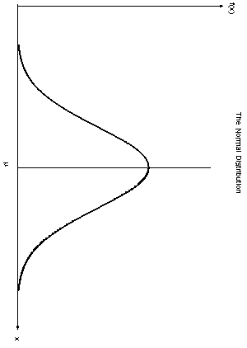
Relationship between heterozygosity, inbreeding coefficient, heterosis and performance.
Brünjes, 2017
What was not fully shown in this diagram?
The parental mean is taken from two homo-zygous parents (unre-lated, different from each other).
The F2 and F3 value is the mean of N=∞ random individuals of F2 or of F3; the segregation variance of these generations might be a point of consideration.
Further inbred genera-tions such as F4, F5 are not shown (inbred with F=7/8 and F=15/16 etc.)
‘Two sides of same coin‘
8
F₁ hybrid
20
7
6
Yield (t/ha)
5
4
3
F₃
Generation
mean
F₂
Gen.
mean
Parental
or F∞
mean
2
Inbreeding
minimum
1
0
Line1
P1
Line2
P2
1.00
0.75
0.50
0.25
0.00
Inbreeding coefficient
Be aware: The idea is that all generations are tested in same environment(s), although our plants are mostly annuals and parents usually are dead as offspring live. What we thus compare is sown partly or fully from stored seed of P1, P2, F1, F2 and F3 etc.

Slide 21
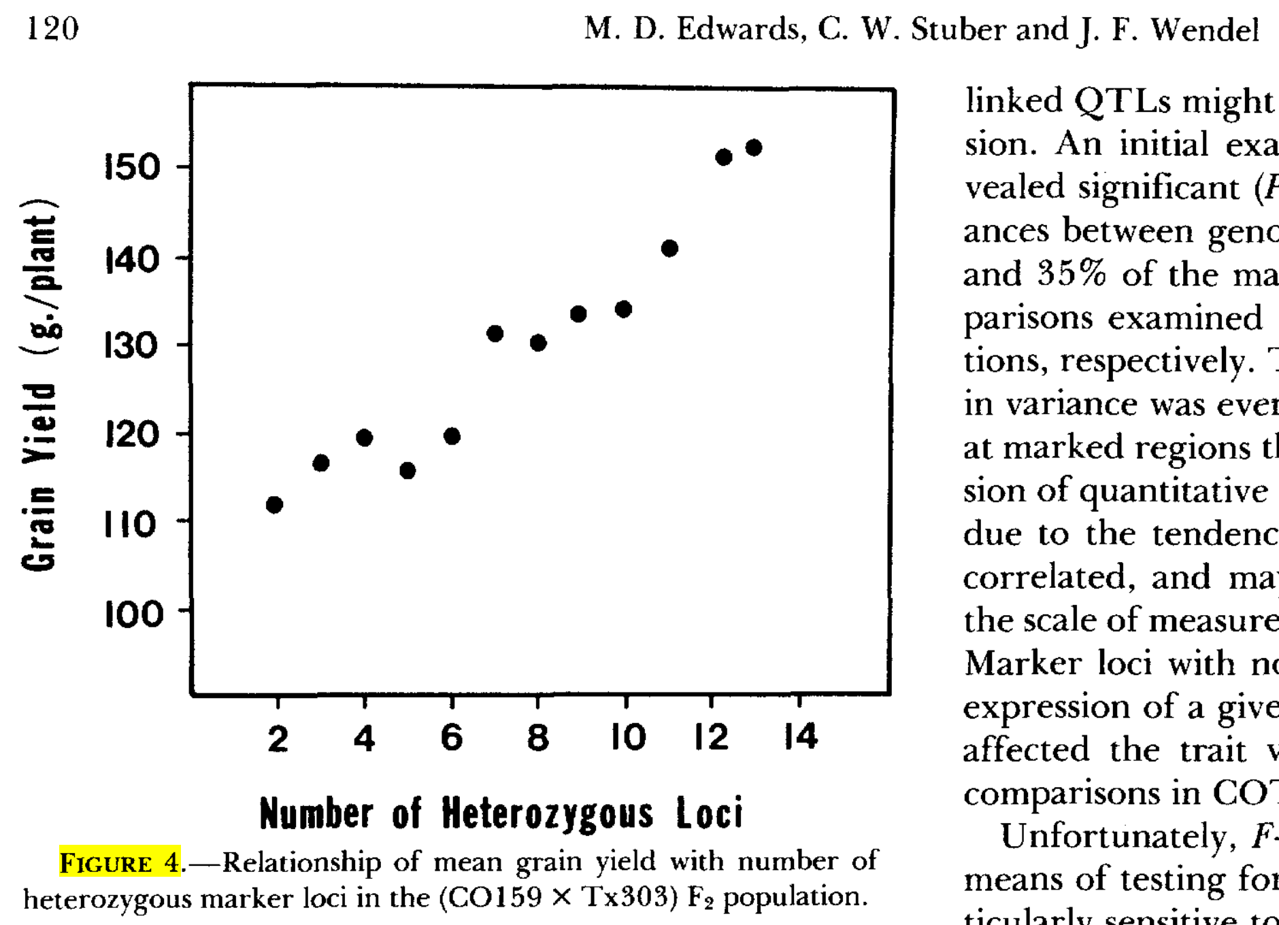
Experimental data on Heterozygosity versus Yield (and Heterosis) in an F2-Population
21
Genetics 116 113-125 (1987)
Examining performance of plants that had from 2 up to 13 of 15 random marker loci in heterozygous status (as very rough proxy for the genome-wide level of hetero-zygosity) showed the importance of heterozygosity on trait expression (grain yield).
It became obvious that level of heterozygosity plays a
large rôle in expression of grain yield.
This is in parallel to the finding that yield in F1 (highly heterozygous) is usually larger than in its homozygous parents and falls from such F1 across F2 and F3 et cetera down to F∞. Take note: Here the variation in heterozygosity came from segregation for heterozygosity; instead of creating variation in heterozygosity in a series of selfing-generations.
F2 population of maize from F1 (CO159 x Tx303). Parents were very different for agronomic traits since one parents was developed in the Southern and the other in the Northern US corn belt region.

Slide 22
Genetic distance of homozygous maize lines; heterosis of their offspring; and
the empirical correlation coefficient r between both parameters.
22
0.0
Schematic representation of parental genetic distances based on DNA-markers and kinship f ; and share of heterosis which is realized in F1 hybrids when crossing two thus-specified parents.
(1) Crosses between more or less related parents.
(2) Intra-group crosses between unrelated parents.
(3) Inter-group crosses with unrelated parents
(4) Inter-group crosses with over-optimum distance. Adapted from Melchinger, 1999 (ISBN: 978-0-891-18255-9).
1.0
(3)
r≈0
(2)
(4)
0.5
0.5
r=low
Kinship (coancestry) f between parents
1-F, i.e. Panmictic index ≈ share of heterosis
If homozygous parents vary for pairwise relatedness f , then their offspring vary accordingly (r=high) for F, thus for heterozygosity and for share of heterosis.
Within a given gene pool, there are very probably (small, hidden, unknown) differences in relatedness, this translates into (some) correlated variation of heterozygo-sity and heterosis.
Crosses between germplasm pools are with kinship
f =0. Variation in parental distances is small, meaningless (r≈0). It does not translate into correlated variation of heterosis (& performance).
(1)
r=high
1.0
0.0
DNA-marker based genetic distance
Max.
(4) Over-optimum distances may occur, depending
on available species‘ diversity.

Slide 23
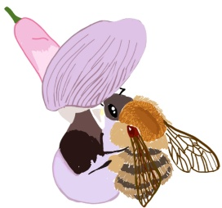
Experimental data on heterosis in a partially allogamous crop (Vicia faba L.)
h² =0.76; LSD(5%) = 0.69
Heterosis in 62 crosses. Hybrid seed was produced by manual crossing (two teams, three seasons of manual crossing ;-) to gather enough seed. The diagonal allows to directly visualize the superiority of F1-hybrids over the mean of their parental inbred lines. Yield data were collected across four environ-ments (north, central, south Germany). Trust-worthy data for yield and heterosis was achieved.
In all crosses, F1 yielded markedly higher than pa-rents. Here, there was no obvious trend that higher yielding inbred lines may lead to less-outperforming hybrids when compared with lower-yielding crosses. Variance for hybrid yield and heterosis was large and significant.
As partial allogamous crop, this species expresses an intermediate level of heterosis, compared with the very high heterosis of outcrossing species (maize, rye, grasses, sugar beet et cetera) and the low heterosis of self-fertilizing species (pea, barley, rice et cetera).
7
7
r = 0.85**
6
6
Zeid et al.,
5
2004
5
Heterosis
h² = 0.79; LSD(5%) = 1.01
Hybrid yield of the corresponding 62 crosses
4
Faba bean data
4
4 environs.; r = 2-4
6m² plot size
3
3
Heterosis
© MT
2
2
2.0
2.0
3.0
3.0
4.0
4.0
5.0
5.0
6.0
6.0
7.0
7.0
Parental means of 62 crosses
23

Slide 24
Impact of favourable vs. unfavourable environmental conditions on size of Heterosis
The extent of Heterosis is very much depending on the actual environment. This is true for e.g. agro-nomic treatments like sowing density (optimum sowing density tends to be higher for inbred lines than for hybrids), and it is as well true for climatic factors including abiotic stress such as drought; and often for biotic stress as well.
The two examples show that the relative (%) superi-ority of hybrids (compared to their parental lines) may increase as the overall yield level decreases.
Message: Inbred lines tend to suffer relatively heavier from stress than their F1-hybrids. Hybrids tend to be more tolerant, resilient, more ‘stable’.
24
Size of Heterosis is trait-specific, population-specific, and specific to environmental conditions.

Slide 25

Impact of favourable vs. unfavourable environmental conditions on size of heterosis
These two examples show again that the relative (%) superiority of hybrids (compared to their parental lines) may increased as the overall yield level decreased.
In the barley example, drought in Syria is shown as major stress factor. The locations were Tel Hadya (284 m altitude) and Breda (300m altitude) near to Aleppo; precipitation hence drought stress varied markedly.
Nota bene: Heterosis is not always ‚positive‘ in agro-nomic sense. Plant height is usually heterotic, hence F1 hybrids tend to lodge more than their (shorter) inbred parents. For monogenic and oligogenic traits such as some quality and resistance traits, the hybrid may deviate from parental mean in favourable as well as unfavourable direction.
Yet, vigour and speed of development show usually ‚favourable‘ heterosis.
Aleppo
https://de.wikipedia.org/wiki/Aleppo
CC “attribution, share alike”
25

Slide 26
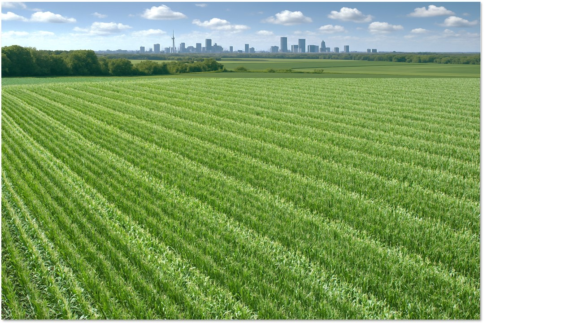
This here is not any more ‘Heterosis’ but the production of seed for a hybrid cultivar
Hence, this is the step into the next chapter.
26

Slide 27
From here you may go to UNPLAB-BrMeth_Ch-3[GCA I]
By the way. Even if I may have written this already ...
“Heterosis is not the larger the more the parents are inbred”.
But:
“The share of heterosis that is visible from comparing parents and F1-offspring is the larger, the more
the parents are inbred; if they are fully inbred, then the full quantum of heterosis is visible”
And:
“The F1-hybrid is not more heterozygous because the parents are more inbred”. No.
“The F1-hybrids is more heterozygous when the parents are genetically more different”. Yes.
At first glance, this may seem counterintuitive. Consider the two crosses  P1(Aa) × P2(Aa) and  P1(AA) × P1(aa). The second cross produces 100% heterozygous offspring, whereas the first produces only 50% (at !this locus). Doesn't this prove that inbred parents produce more heterozygous F1 hybrids? No! Crossing AA x aa is a cherry picked cross. The probability to have as female gamete ‘A’ and as male gamete ‘a’ is basically p(A) and q(a);
➔ This is true if gametes were taken at random from the HWE population;
➔ This is true if gametes were taken at random from that same population after inbreeding it to F=1 (you know, no selection mutation drift migration). Think about this. It is even true with parents from the population at 0<F<1 (...)
Inbreeding alone changes genotype frequencies, not allele frequencies. Gametes carry alleles, not genotypes. Therefore, the basic probability of drawing allele A from the breeding population remains p, regardless of parental F. The expected heterozygosity of a random F1 is basically 2pq per locus, irrespective of whether parents were taken from the HWE population of from a more or less inbred version of it.
Inbreeding produces "fixed" alleles; it does not decide which alleles become fixed. Complementarity between parents must come from parental difference, not from inbreeding – and only parental difference causes heterozygosity in F1.
Heterozygous parents do not necessarily produce heterozygous offspring. Different parents do.
A further hint: Imagine this cross ... P1(A1A2) x P2(A3A4). F1 is fully heterozygous although parents are heterozygous, too ;-)
27

